Slide 1
Data gathering
Simina Boca, PhD, MHS
Faculty, Innovation Center for Biomedical Informatics (ICBI)
Assistant Professor, Departments of Oncology and
Biostatistics, Bioinformatics and Biomathematics
Georgetown University Medical Center
April 23, 2019

Slide 2
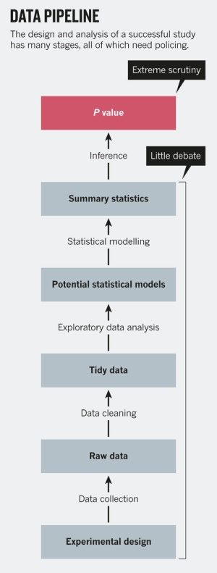
Data analysis is a many-stage process
From Leek and Peng, Nature, 2015
https://www.nature.com/news/statistics-p-values-are-just-the-tip-of-the-iceberg-1.17412

Slide 3
Data analysis is a many-stage process
From Leek and Peng, Nature, 2015
I spend a lot of time here!
I want to understand the data and the scientific question of interest really well before just returning a list of genes/proteins/metabolites of interest.
https://www.nature.com/news/statistics-p-values-are-just-the-tip-of-the-iceberg-1.17412

Slide 4
Data analysis is a many-stage process
From Leek and Peng, Nature, 2015
Having an appropriate study design is essential, as is having the data in an analysis-ready format.
https://www.nature.com/news/statistics-p-values-are-just-the-tip-of-the-iceberg-1.17412

Slide 5
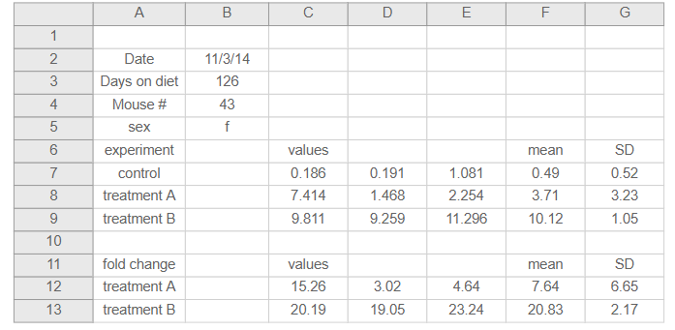
Organizing data into spreadsheets
How many times have you created/received a spreadsheet that looks like this?
https://kbroman.org/dataorg/

Slide 6
Organizing data into spreadsheets
How many times have you created/received a spreadsheet that looks like this?
Why is this bad?
https://kbroman.org/dataorg/

Slide 7
Organizing data into spreadsheets
What about data with inconsistent labels?

Slide 8
Organizing data into spreadsheets
What about data with inconsistent labels?:
Breast cancer
Cancer, breast
Neoplasm, breast
Breast neoplasm
Breast cancer, NOS
Breast malignancy
breast cancer

Slide 9
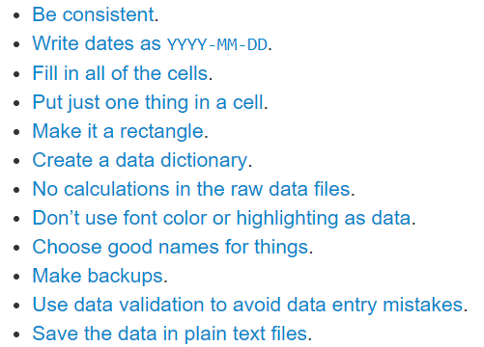
Organizing data into spreadsheets: Karl Broman’s principles
https://kbroman.org/dataorg/

Slide 10
Organizing data into spreadsheets
Set up your dataset so that it:
Reduces the chance of errors (and makes them easy to identify)
Makes it easy to update (if applicable)
Makes it easy to read in the dataset and perform analyses on it (computability)!

Slide 11
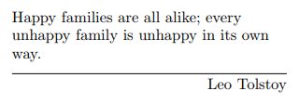
Tidy data
Definition due to Hadley Wickham (2014, Journal of Statistical Software), based on concepts from relational databases (screenshots from this paper on following slides)
Goal is to “link the structure of a dataset (its physical layout) with its semantics (its meaning)”

Slide 12
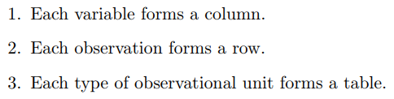
Tidy data
Tidy data:

Slide 13
Tidy data
Tidy data:
Messy data:
Anything else!

Slide 14
Tidy data can simplify analyses
It can be easier to manipulate datasets when there is a consistent way to refer to variables
Wickham considers “4 fundamental verbs” for data manipulation:
Filter
Transform
Aggregate
Sort

Slide 15
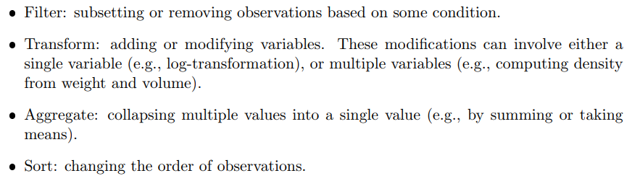
Tidy data can simplify analyses
4 fundamental verbs (initial):

Slide 16
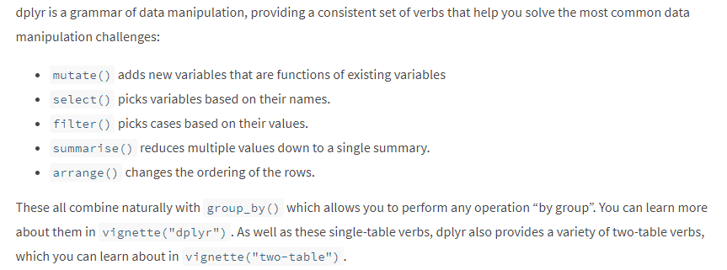
Tidy data can simplify analyses
6 fundamental verbs (current):
https://dplyr.tidyverse.org/

Slide 17
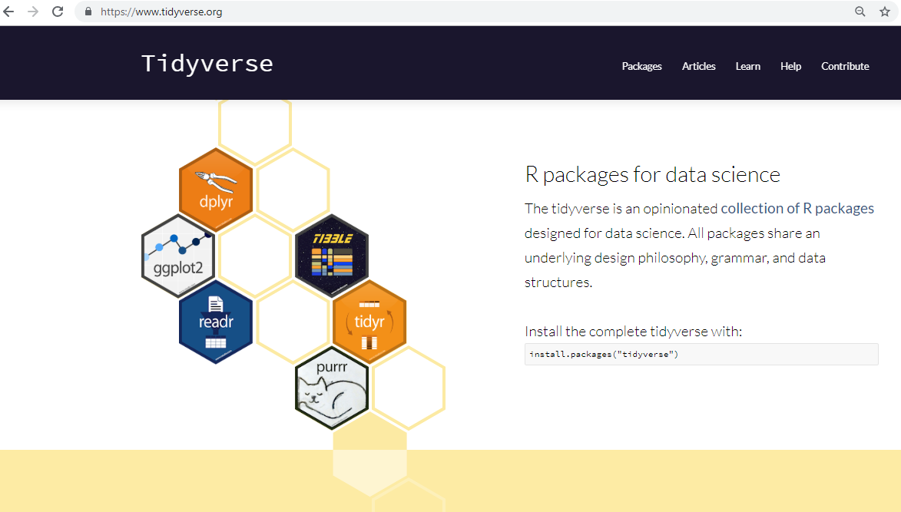
Many R packages built for tidy data analysis!

Slide 18
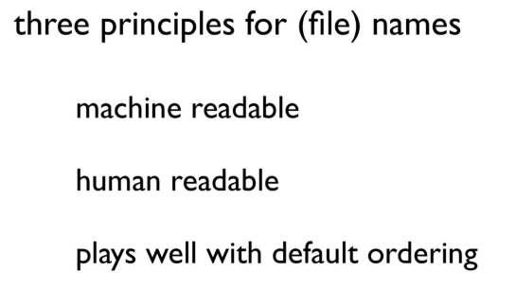
Naming things
Slides by Jenny Bryan (screenshots from her presentation on following slides)
https://speakerdeck.com/jennybc/how-to-name-files

Slide 19
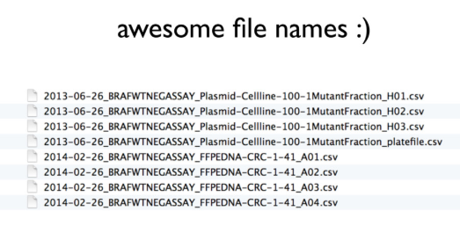
Naming things
https://speakerdeck.com/jennybc/how-to-name-files

Slide 20
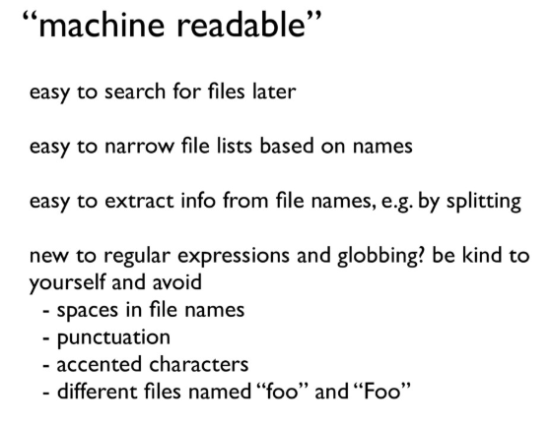
Naming things
https://speakerdeck.com/jennybc/how-to-name-files

Slide 21
Naming things
“human readable”
Easy to figure out what something is, based on its name
https://speakerdeck.com/jennybc/how-to-name-files

Slide 22
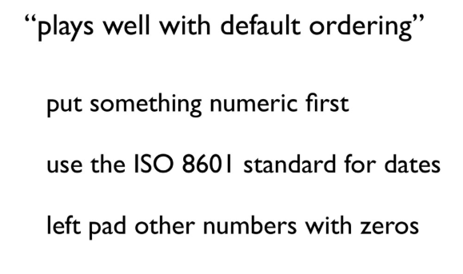
Naming things
https://speakerdeck.com/jennybc/how-to-name-files

Slide 23
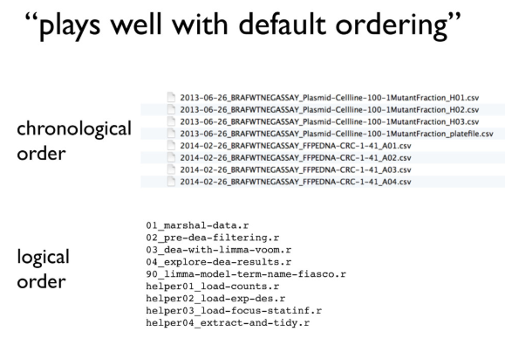
Naming things
https://speakerdeck.com/jennybc/how-to-name-files

Slide 24
Naming things: ISO 8601 standard avoids potential date confusion
Is 02/22/14 February 22, 1914 or February 22, 2014?
Is 02/01/2014 February 1, 2014 or January 2, 2014?
Depends on the country!

Slide 25
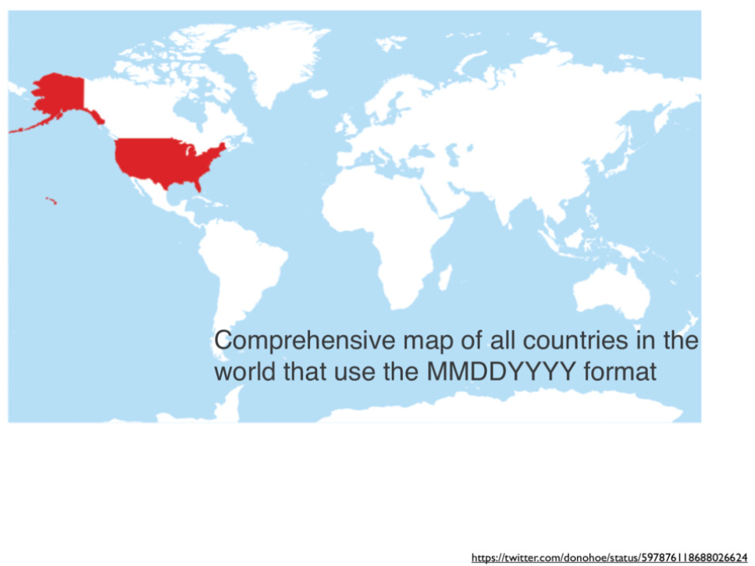
Naming things: ISO 8601 standard avoids potential date confusion
https://speakerdeck.com/jennybc/how-to-name-files

Slide 26
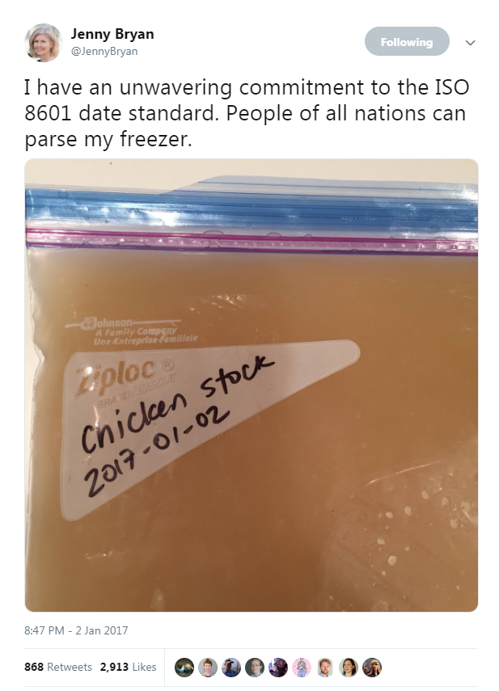
Naming things: ISO 8601 standard makes sorting easier
https://twitter.com/JennyBryan/status/816143967695687684

Slide 27

If you’re inputting data, consider alternatives to spreadsheets…
REDCap is a web-based application designed to provide Researchers and Clinicians an easy way to create and manage databases and surveys in order to support data capture for research studies.
Thanks to Shruti Rao at ICBI/Georgetown for REDCap content

Slide 28
Benefits of REDCap
Access through secure login page
Supports multiple project types, from simple surveys to complex longitudinal clinical trials
Includes data quality features like: range checking, structured data dictionary, mandatory fields
Can still export as a spreadsheet (though I usually first save it as a plain tsv/csv text file before reading it into R)
https://labkey.med.ualberta.ca/labkey/wiki/REDCap%20Support/page.view?name=rcadvantage

Slide 29
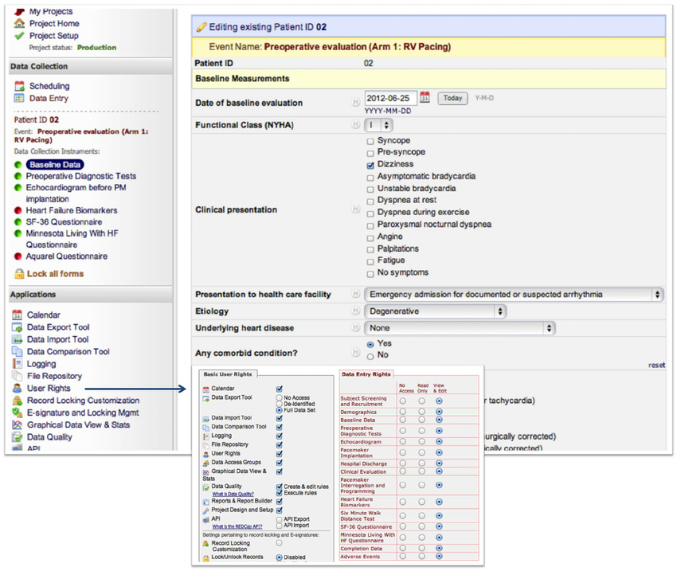
REDCap data entry form example
https://www.ncbi.nlm.nih.gov/pubmed/23936257

Slide 30
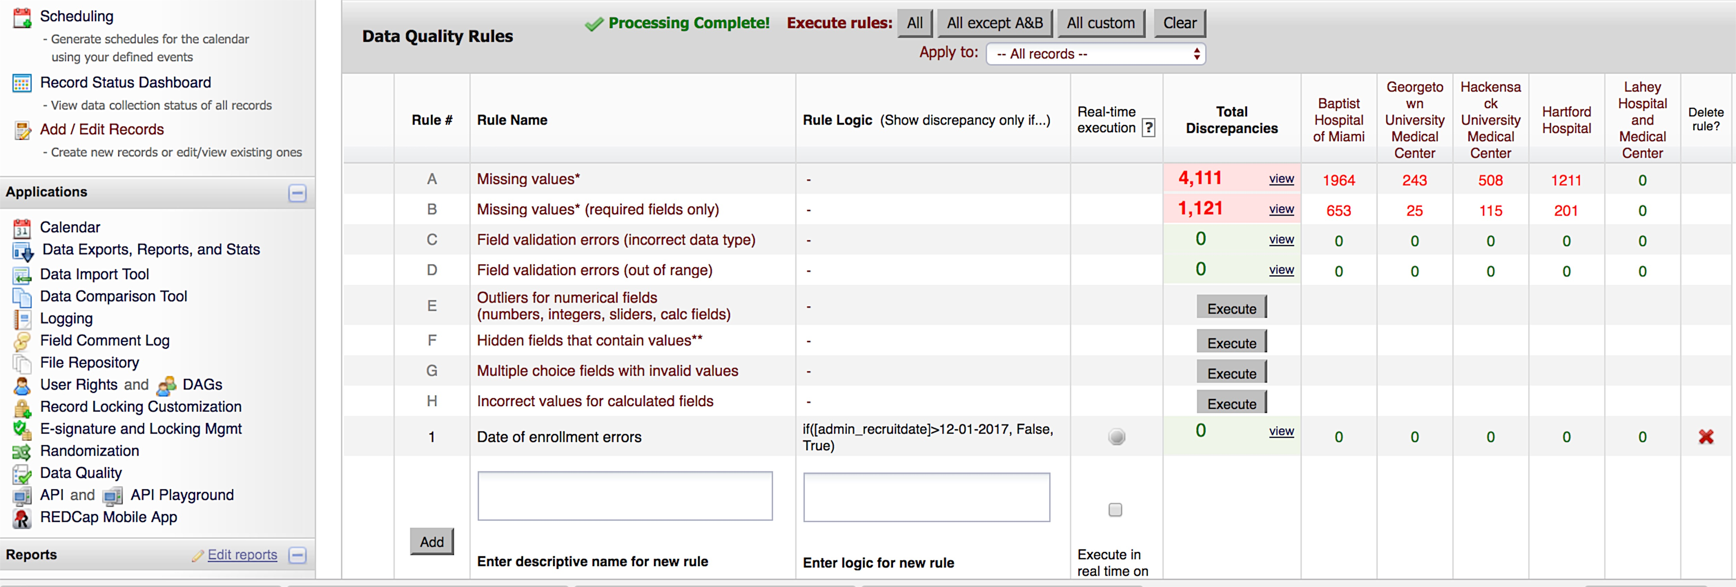
Data quality checks in REDCap
Thanks to Shruti Rao at ICBI/Georgetown for REDCap content

Slide 31
Exploratory data analysis
Before doing any modeling/hypothesis testing, make sure to check for:
Missing values
Outliers and other artifacts
Can be subtle, however obvious examples can include negative values for age, different units for weight/height, clearly incorrect (biologically impossible) measurements
See if any samples look “different” from the majority of the samples
Use tables and plots for this!
https://leanpub.com/exdata
https://siminab.github.io/2018/09/05/omics-exploratory-data-analysis-checklist/

Slide 32
Missing data
Prevention is the best cure!
There are many approaches for trying to deal with missing data, but it’s better to set up a design that minimizes missing data and/or to do your best to follow up on records with missing information

Slide 33
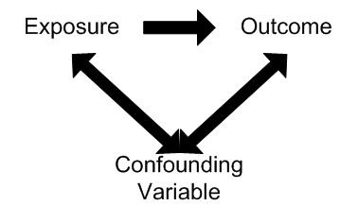
Exploratory data analysis
Helpful to check for different kinds of confounding!
Other variables besides those being studied could influence the exposure/outcome relationship being studied
Example: Socioeconomic factors can confound relationship between diet and risk of a disease
https://www.healthknowledge.org.uk/e-learning/epidemiology/practitioners/chance-bias-confounding

Slide 34
Different types of plots
Plotting your data is essential for data exploration, interpretation, and communication of results
When making a plot, consider the type of data and how to make the plot as informative as possible
Generally want to keep as much of the original data in the plot as possible but often will need to reduce it in some way without creating artifacts
The following plots are from https://leanpub.com/datastyle (with my annotations)

Slide 35
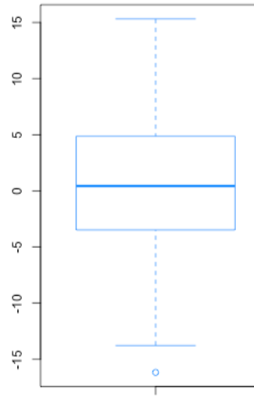
Boxplots
A boxplot shows the median, the 1st quartile (Q1), the 3rd quartile (Q3), and “whiskers” up to some range (default is usually 1.5*(Q3-Q1) from the box)
Q3
Median
Middle 50% of data points
Q1
Outlier

Slide 36
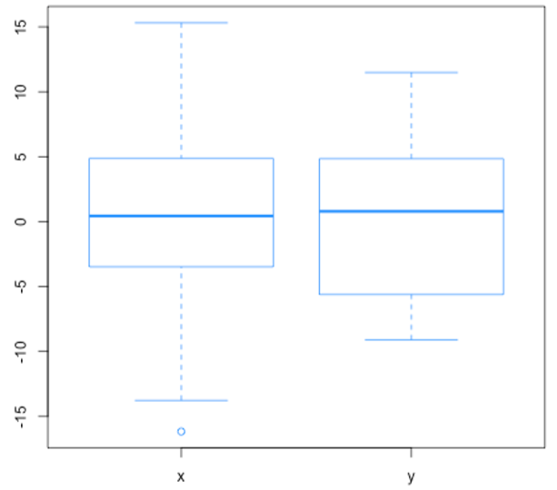
Boxplots
These boxplots look similar…

Slide 37
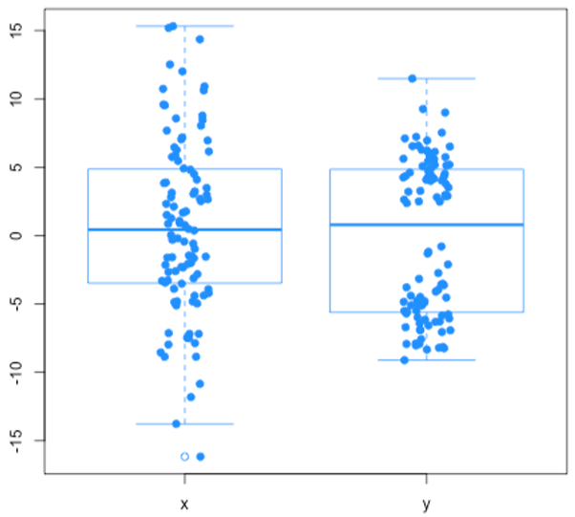
Boxplots
… but if you overlay the data points, you’ll see the distributions are very different…

Slide 38
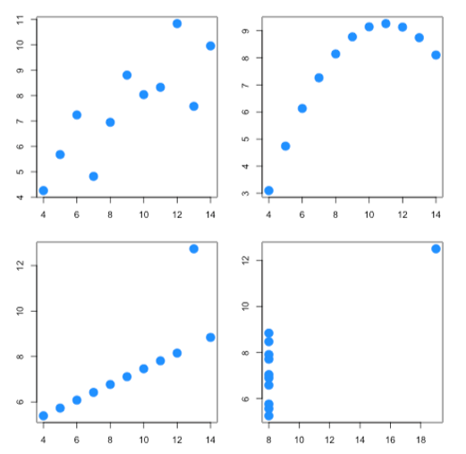
Plots can be more informative than single-number summaries!
All these datasets have the same correlation between the two variables!

Slide 39
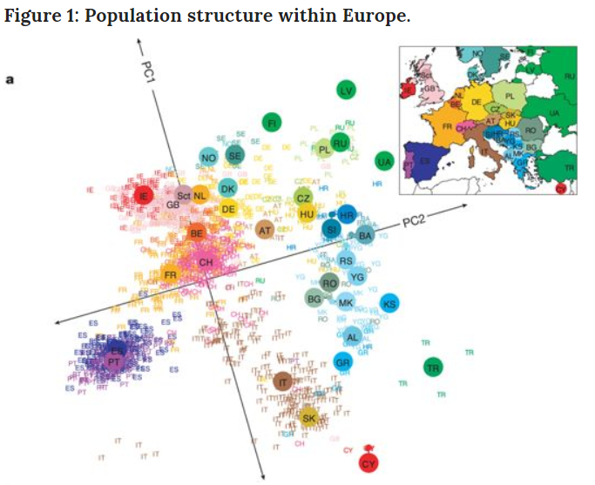
Can use point color, type, and size to add extra information
Can think of it as adding “extra dimensions” to a 2D plot!
https://www.nature.com/articles/nature07331

Slide 40
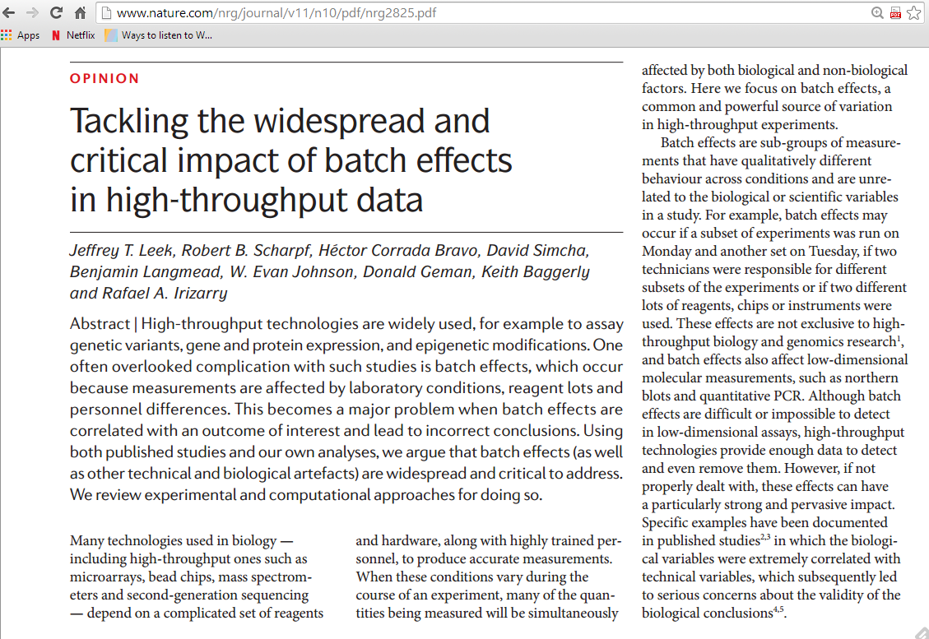
Batch effects: A type of confounding

Slide 41
Batch effects: A type of confounding
From the same paper:
“The first step in addressing batch and other technical artefacts is careful study design. Experiments that run over long periods of time and large-scale experiments that are run across different laboratories are highly likely to be susceptible. But even smaller studies performed within a single laboratory may span several days or include personnel changes.
High-throughput experiments should be designed to distribute batches and other potential sources of experimental variation across biological groups . For example, in a study comparing a molecular profile in tumour samples versus healthy controls, the tumour and healthy samples should be equally distributed between multiple laboratories and across different processing times. These steps can help to minimize the probability of confounding between biological and batch effects”

Slide 42
Batch effects: A type of confounding
Prevention is the best cure!
Randomize/equally allocate at each step of the way, to the extent that this is possible!:
Randomize treatments/conditions (if applicable)
Do not collect all cases from one hospital, all controls from another hospital
Do not take measurements from cases and controls at different times (eg. morning vs. afternoon, fasting vs. non-fasting)
Do not handle cases and controls separately (different labs, conditions, reagents, technicians, order of analysis)

Slide 43
Visualizing big data
“To visualize big data you have to make it into small data.”
Measuring the expression of 20,000 genes leads to a 20,000-dimensional vector for each sample
We can only really visualize this if we reduce the dimensionality to 2 dimensions

Slide 44
Visualizing big data
Multiple ways to reduce dimensionality, including:
Principal components analysis (PCA) obtains directions that explain the most variance in the data
Multidimensional scaling (MDS) tries to preserve distances when reducing number of dimensions
Both offer “global views” of the data and are helpful for identifying global trends, outliers, artifacts etc

Slide 45
Visualizing big data
Multiple ways to reduce dimensionality, including:
Principal components analysis (PCA) obtains directions that explain the most variance in the data
Multidimensional scaling (MDS) tries to preserve distances when reducing number of dimensions
Many other approaches (non-negative matrix factorization, independent component analysis etc)

Slide 46
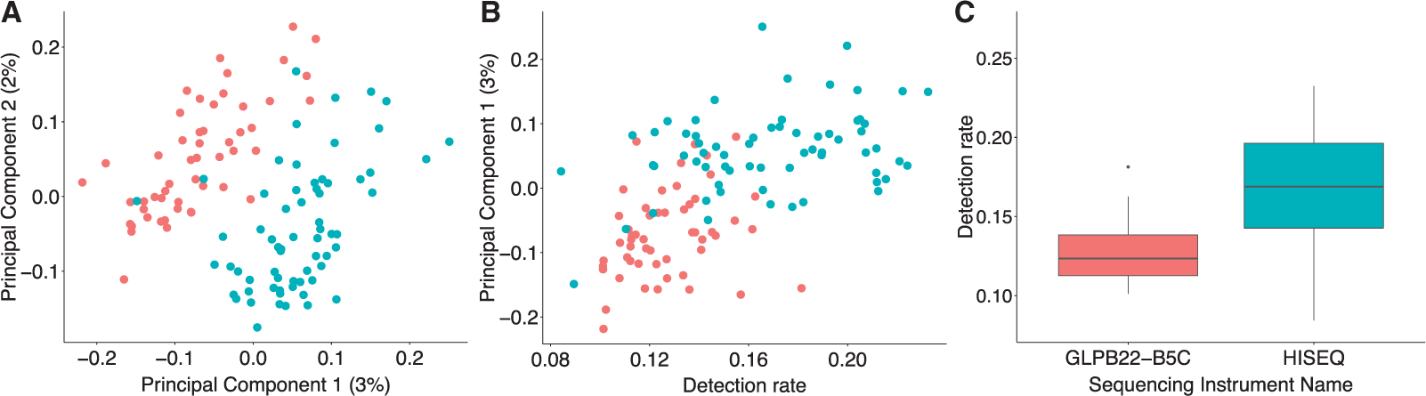
Technical variation can lead to different detection rates and false differences
Hicks et al, 2018, Biostatistics
https://academic.oup.com/biostatistics/article/19/4/562/4599254

Slide 47
My Coordinates
Email: smb310@georgetown.edu
Twitter handle: @siminaboca
Websites: http://icbi.georgetown.edu/Boca
https://sites.google.com/georgetown.edu/siminaboca/

